Slide 1
How to Build a Robust and Profitable OTT Ecosystem

Slide 2
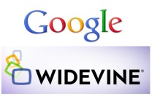
OTT Ecosystem
Content Provider
Personalization
Advertising
Delivery
Content Management
Streaming
Identity Management
App UX/Device Integration
Metadata
Transcoding/Packaging
Analytics/Monitoring
Devices
Cloud Services
DRM/WaterMarking
App/Video Player
Payment/Billing

